Slide 1
2nd Article:
Costs and potential of carbon capture and storage at an
integrated steel mill
(Finland)

Slide 2
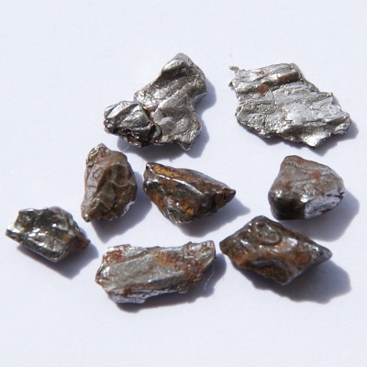
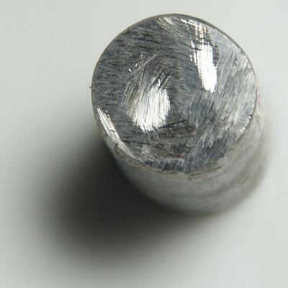
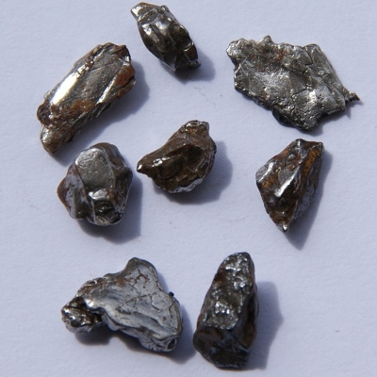
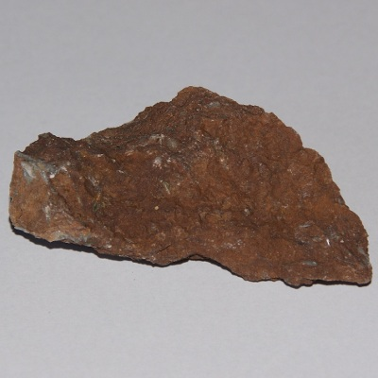
IRON (noun)
A silvery-white, ductile, magnetic, metallic element occurring in combined forms and used alloyed in a wide range of important structural materials. Atomic number 26; atomic weight 55.845; melting point 1,535°C; boiling point 2,750°C; specific gravity 7.874 (at 20°C). Symbol Fe

Slide 3
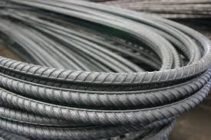
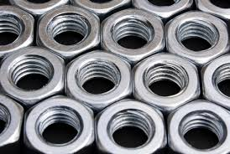
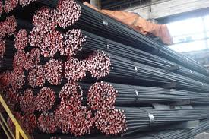
STEEL (Noun)
A generally hard, strong, durable, alloy of iron and carbon, usually containing between 0.2 and 1.5 percent carbon, often with other constituents such as manganese, chromium, copper, or silicon, depending on the desired alloy properties, and widely used as a structural material.

Slide 4
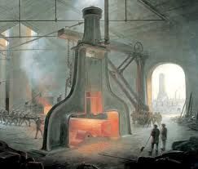
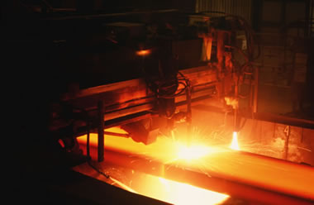
STEEL MILL
A factory where steel is made
Mill (Noun): A machine or device that reduces a solid or coarse substance into grains by crushing or pressing: a pepper mill.

Slide 5
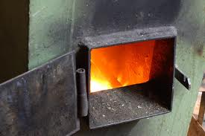
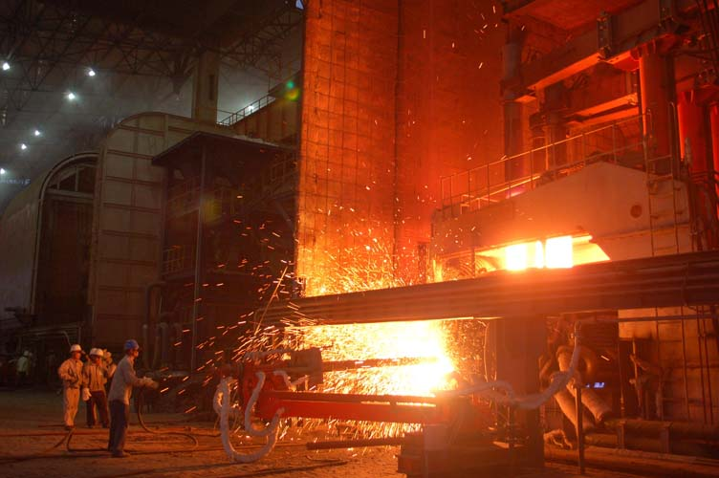
FURNACE (NOUN)
An enclosure in which energy in a non-thermal form is converted to heat, especially such an enclosure in which heat is generated by the combustion of a suitable fuel.
A Blast Furnace: A furnace in which combustion is intensified
by a blast of air.

Slide 6
COMBUSTION (NOUN)
The process of burning
(Chemistry) Any process in which a substance reacts with oxygen to produce a significant rise in temperature and the emission of light.
POST COMBUSTION
Post: A prefix, meaning “after, subsequent to,” “behind.

Slide 7
EMISSIONS
Noun
The act or an instance of emitting.
A substance discharged into the air, especially by an internal combustion engine. Emission may refer to:
Flue gas, also:
Exhaust gas: flue gas occurring as a result of the combustion of a fuel.
Emission of air pollutants: Emission of greenhouse gases, a gas in an atmosphere that absorbs and emits radiation within the thermal infrared range.
Emission (electromagnetic radiation), the process by which the energy of a photon is released by another entity.
Emission (radiocommunications), the radio signal (usually modulated) emitted from a radio transmitter.

Slide 8
FEASIBILITY
Capability of being accomplished or brought about; being possible.
Being used or dealt with successfully; being suitable, logical, likely.
Feasible (adj): Ex: A feasible explanation. Feasible new sources of energy. A feasible plan
Ex: In this study different possibilities and the feasibility of applying carbon capture at an integrated steel mill based on blast furnace process, in order to reduce carbon dioxide emissions were studied.

Slide 9
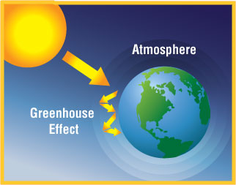
GREENHOUSE GASES (NOUN)
A greenhouse gas (GHG) is a gas in an atmosphere that absorbs and emits radiation within the thermal infrared range.
The primary GHGs in the atmosphere are water vapor, carbon dioxide (CO₂), methane (CH₄), nitrous oxide (NO₂), and ozone.

Slide 10
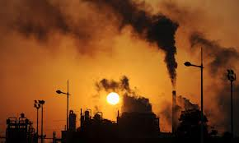
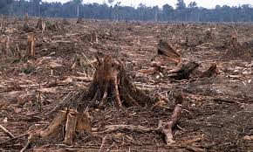
GREENHOUSE GASES (NOUN)
Although GHGs occur naturally in the atmosphere, the elevated levels especially of CO₂ and CH₄ that have been observed in recent decades are directly related, at least in part, to human activities such as the burning of fossil fuels and the deforestation of tropical forests.

Slide 11
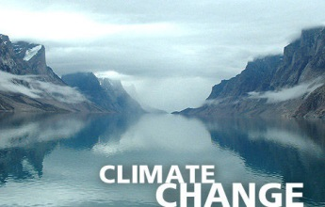
CLIMATE CHANGE
A change in the world's climate
It is a significant and lasting change in the statistical distribution of weather patterns over periods ranging from decades to millions of years.
It may be a change in average weather conditions, or in the distribution of weather around the average conditions (i.e., more or fewer extreme weather events).

Slide 12
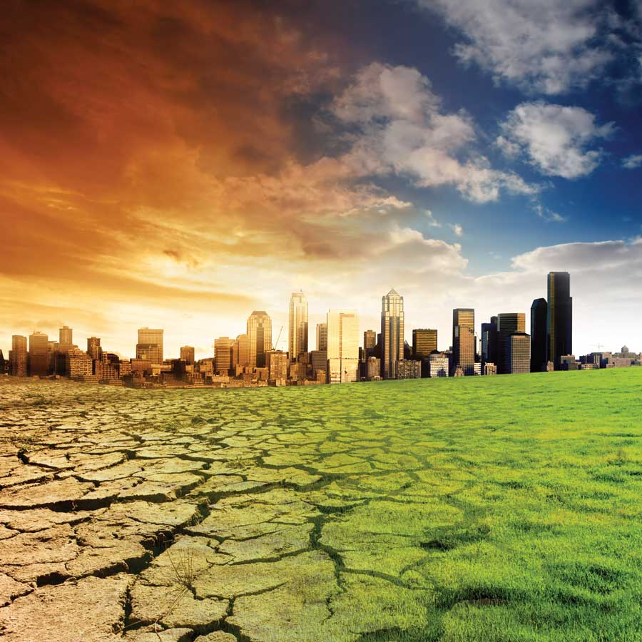
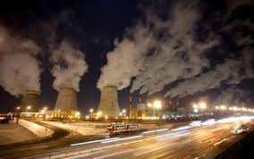
CLIMATE CHANGE
Climate change is caused by factors such as biotic processes, variations in solar radiation received by Earth, plate tectonics, and volcanic eruptions.
Certain human activities have also been identified as significant causes of recent climate change, often referred to as "global warming".
Scientists actively work to understand past and future climate by using observations and theoretical models.

Slide 13
FOSSIL SOURCES
The remains or imprint of an organism from a previous geologic time.
Fossil fuels are fuels formed by natural processes such as anaerobic decomposition of buried dead organisms. The age of the organisms and their resulting fossil fuels is typically millions of years.
Fossil fuels contain high percentages of carbon and include coal, petroleum, and natural gas.
They range from volatile materials with low carbon:hydrogen ratios like methane, to liquid petroleum to nonvolatile materials composed of almost pure carbon, like anthracite coal.

Slide 14
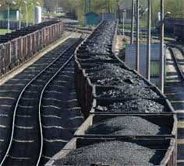
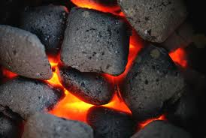
COAL (NOUN)
(Earth Sciences / Minerals)
A combustible compact black or dark-brown carbonaceous rock formed from compaction of layers of partially decomposed vegetation: a fuel and a source of coke, coal gas, and coal tar.

Slide 15
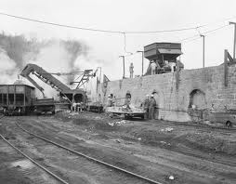
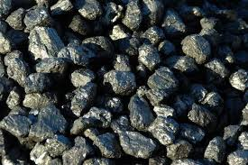
COKE (NOUN)
(Chemistry)
A solid-fuel product containing about 80 per cent of carbon produced by distillation of coal to drive off its volatile constituents: used as a fuel and in metallurgy as a reducing agent for converting metal oxides into metals.

Slide 16
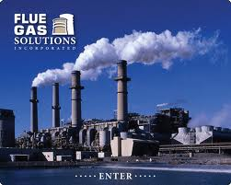
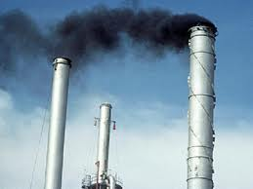
FLUE GAS (NOUN)
Engineering / General Engineering
The smoke in the uptake of a boiler fire: it consists mainly of carbon dioxide, carbon monoxide, and nitrogen.
Flue gas is the gas exiting to the atmosphere via a flue, which is a pipe or channel for conveying exhaust gases from a fireplace, oven, furnace, boiler or steam generator. Quite often, the flue gas refers to the combustion exhaust gas produced at power plants.

Slide 17
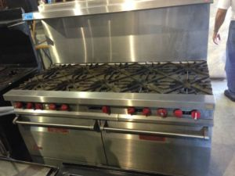
STOVE (NOUN)
An apparatus in which electricity or a fuel is used to furnish heat.
A device that produces heat for specialized, especially industrial, purposes.

Slide 18
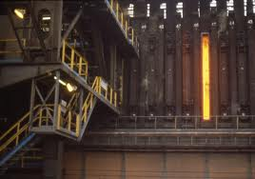
OVEN (NOUN)
A chamber or enclosed compartment for heating, baking, or roasting food, as in a stove, or for firing, baking, hardening, or drying objects, as in a kiln.
COKE OVEN

Slide 19
SOLVENT
A substance that dissolves resulting in a solution.
A solvent is usually a liquid but can also be a solid or a gas.
The maximum quantity that can dissolve in a specific volume of solvent varies with temperature.
Common uses for organic solvents are in dry cleaning (e.g.,tetra chloro ethylene), as paint thinners, as nail polish removers and glue solvents, in detergents, in perfumes, nail polish and in chemical synthesis.
The use of inorganic solvents (other than water) is typically limited to research chemistry and some technological processes.

Slide 20
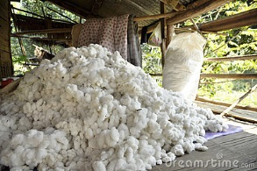
RAW MATERIAL (NOUN)
1. An unprocessed natural product used in manufacture.
2. Unprocessed material of any kind: These data are the raw material for the analysis.
The pile of raw cotton together. In the agricultural sector.

Slide 21
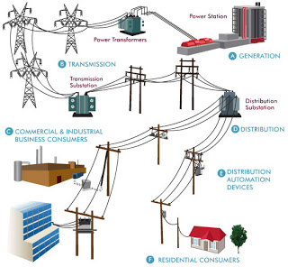
NATIONAL ELECTRICITY GRID
It is an interconnected network for delivering electricity from suppliers to consumers.
It consists of generating stations that produce electrical power, high-voltage transmission lines that carry power from distant sources to demand centers, and distribution lines that connect individual customers.

Slide 22
ELECTRICITY PRICE
Electricity pricing (sometimes referred to as electricity tariff or the price of electricity) varies widely from country to country, and may vary significantly from locality to locality within a particular country.
There are many reasons that account for these differences in price. The price of power generation depends largely on the type and market price of the fuel used, government and industry regulation, and even local weather patterns.

Slide 23
DISTRICT HEATING
District heating is a system for distributing heat generated in a centralised location for residential and commercial heating requirements such as space heating and water heating.
District heating plants can provide higher efficiencies and better pollution control than localized boilers.

Slide 24
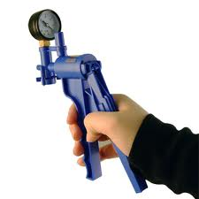
VACUUM PRESSURE
Vacuum (noun): Free space
(Vacuum Cleaner: A machine that cleans carpets etc by sucking dust etc into itself.)
Vacuum pressure refers to the internal pressure that is below the atmospheric pressure.
Hand Vacuum Pump

Slide 25
SCRUBBING PROCESS
The process of cleaning a surface by rubbing
Scrubber systems are a diverse group of air pollution control devices that can be used to remove some particulates and/or gases from industrial exhaust streams.
Traditionally, the term "scrubber" has referred to pollution control devices that use liquid to wash unwanted pollutants from a gas stream.
Recently, the term is also used to describe systems that inject slurry into a dirty exhaust stream to "wash out" acid gases.
Scrubbers are one of the primary devices that control gaseous emissions, especially acid gases.

Slide 26
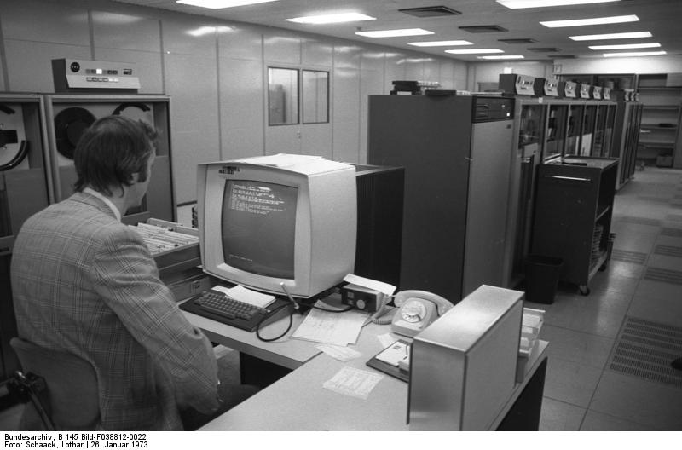
ELECTRONIC DATA PROCESSING (EDP)
It can refer to the use of automated methods to process commercial data.
Typically, this uses relatively simple, repetitive activities to process large volumes of similar information.
For example:
banking transactions applied to account and customer master files,
booking and ticketing transactions to an airline's reservation system.
Electronic data processing in the Volkswagen factory Wolfsburg, 1973

Slide 27
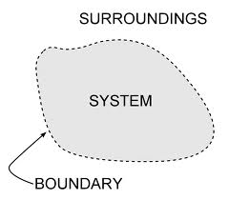
BOUNDARY (NOUN)
Something that indicates a border or limit.
Ex.: The system boundary is selected to only include all process units affected by the change.

Slide 28
SCALE
Noun
a. A proportion used in determining the dimensional relationship of a representation to that which it represents: a world map with a scale of 1:4,560,000.
b. A calibrated line, as on a map or an architectural plan, indicating such a proportion.
c. Proper proportion: a house that seemed out of scale with its surroundings.

Slide 29
PREHEATED AIR
Preheat (verb):
To heat before using or before subjecting to a further process.
Ex.: Preheat the incoming air for combustion.
INTEGRATION
Noun
The act or process of integrating.
Electronics The process of placing more than one integrated circuit on a single chip.
Ex.: Heat integration is the most important connection of process units, when considering the application of post combustion capture processes on site.

Slide 30
AUTOMATED OPERATIONS
Automated (adj): operated by automation
Operation (noun):
1. The act or process of operating or functioning.
2. The state of being operative or functional:
a factory in operation.
3. A process or series of acts involved in a particular form of work:
the operation of building a house.
4. An instance or method of efficient, productive activity:
That restaurant is quite an operation.

Slide 31
ANNUAL CASH FLOW
The amount of net cash generated by an investment or a business during a specific period. (Annual: Yearly)
One measure of cash flow is earnings before interest, taxes, depreciation, and amortisation.
Because cash is the fuel that drives a business, many analysts consider cash flow to be a company's most important financial statistic.

Slide 32
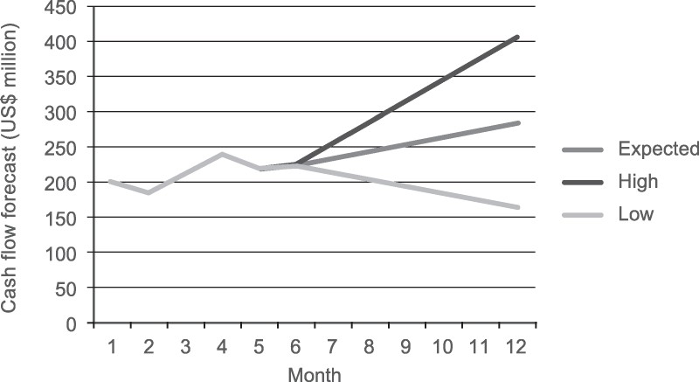

Slide 33
CONVENTIONAL
adj.
Based on or in accordance with general agreement, use, or practice.
Something widely accepted. (Traditional)
Ex.: conventional symbols; a conventional form of address.
Ex.: The replacement of a conventional blast furnace with an oxygen blast furnace affects only a part of processes at an integrated steel mill.
Conventional Sources of Energy: Oil, Natural Gas, Coal, Petroleum
Non-Conventional Sources of Energy: Nuclear, Wind, Solar, Tidal, Geothermal.

Slide 34
PERMANENT
Adj
Lasting or remaining without essential change.
Not expected to change in status, condition, or place: a permanent address; permanent secretary to the president.
(Temporary X Permanent)
STORAGE
Noun
The act of storing goods or the state of being stored.
Ex.: The separated CO₂ is purified, compressed and sent to a permanent storage.

Slide 35
OPTIMISATION
Noun
The procedure or procedures used to make a system or design as effective or functional as possible, especially the mathematical techniques involved.
OPTIMISE
Verb
To make optimal; get the most out of; use best;
‘optimise your resources’
To modify to achieve maximum efficiency in storage capacity or time or cost;
"optimis(z)e a computer program"

Slide 36
SENSITIVITY
Noun
The responsiveness of a system to a change.
Sensitivity testing is the process of changing the value of constants in the model and examining the resulting output. (Monte Carlo)
This analysis helps to explain the effect of change in value of constants on the outputs of some other pre-specified parameter(s).

Slide 37
ALTERNATIVE
Noun
The choice between two possibilities.
A situation presenting a choice
Ex.: When different solvent options are considered, low temperature solvent was the considered to be the best alternative.
INVESTOR (Noun)
Someone who commits capital in order to gain financial returns.
Invest: (Verb) To put valuable resources into something that you expect will give you a personal or financial gain.
An example of invest is to start a new business, spending time now to generate income later.

Slide 38
PROFIT
Noun
An advantageous gain or return; benefit.
The return received on a business undertaking after all operating expenses have been met.
PROFITABILITY
adj.
Yielding profit; advantageous or lucrative.
Ex.: Despite the fact that the oxygen blast furnaces seems to be more economical solution, the overall profitability and the effects on the production costs of steel are more complicated.

Slide 39
TO PRODUCE
Verb
To create by physical or mental effort
To manufacture: factories that produce cars and trucks.
To cause to occur or exist; give rise to: chemicals that produce a noxious vapor when mixed.
GENERATION
Noun
A stage of technological development distinct from but based upon another stage: a new generation of computers.
(Physics / General Physics) production of electricity, heat, etc.

Slide 40
TO CONSIDER
Verb
To decide, keep in mind, or believe as true.
An example of consider is thinking about two possible options.
An example of consider is believing a person committed a crime after seeing evidence.
TO CAPTURE
Verb
To take hold of or control of, often by force.
An example of to capture is to take a prisoner of war.

Slide 41
TO EVALUATE
Verb
To evaluate is defined as to judge the value or worth of someone or sth.
An example of evaluate is when a teacher reviews a paper in order to give it a grade.
TO ENABLE
Verb
To make something possible.
Ex.: To enable sufficient temperature profile, gas flow and to increase the utilization rate of the coal a part of the blast furnace top gas is recycled back to the furnace.

Slide 42
TO INVESTIGATE
Verb
To look into sth or someone in order to try to discover the truth or to piece together a sequence of events.
An example of investigate is when you run a background check on someone to find out what kind of person he is.
An example of investigate is when the police try to solve a crime.
An example of investigate is when you check the source of material to determine its truth.

Slide 43
TO RECYCLE
Verb
To use again or to reuse waste material by converting it into something new.
An example of recycle is when you return bottles, which are then processed into new glass products.
TO SEPARATE
Verb
To pull apart, disconnect or divide.
An example of separate is pulling a piece of string cheese off of the whole piece of cheese.
An example of separate is removing the charger from an mp3 player.

Slide 44
TO REDUCE
Verb
To bring down, as in extent, amount, price or degree; diminish.
Ex.: The main effect on the energy balance of the plant is a reduced amount of coke. (adj)
TO INJECT
Verb
To force or drive (a fluid) into some passage, cavity, or chamber; esp., to introduce or force (a liquid) into some part of the body by means of a needle, etc.

Slide 45
TO SUPPLY
Verb
To make available for use; provide.
Ex.: In general, if more waste heat is recovered, power plant can produce more electricity instead of supplying utility steam.
TO DIMINISH
Verb
To make smaller or less or to cause to appear so.
Ex.: Therefore the power and heat production is drastically diminished at the power plant.

Slide 46
TO COMPARE
Verb
To examine in order to note the similarities or differences of.
Ex: Broadband subscriptions rose to 69.2% compared with 49.1% in March 2005.
TO PENETRATE
Verb
To enter or force a way into, to pass into or through sth.
Ex.: The bullet penetrated the wall.

Slide 47
TO RESEMBLE
Verb
To look like something or someone else or to have similar features as something or someone else.
Ex.: In principle the process resembles a lot like a conventional blast furnace process.

