Slide 1
NIKOLA TESLA’S RADIATIONS AND THE COSMIC RAYS

Slide 2
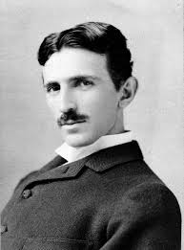
Who is Tesla?
Electrical Engineer
Mechanical Engineer
Physicist
Alternating Current
High Voltage
High Frequency
Power Experiment

Slide 3
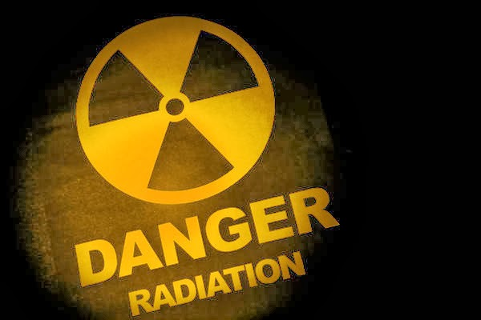
The Radiations
1-)Small particles
2-)Positive charge
3-)Speed
4-)The nucleus of the atoms
5-)Vacuum tube
6-)Absorbed by celestial bodies

Slide 4
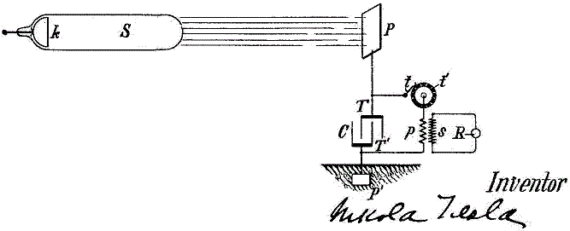
Radiant Energy
Radiant Energy is the energy of electromagnetic radiation.
This radiation may be visible or invisible to the human eye.
Radiant energy is used particularly when electromagnetic radiation is emitted by a source into the surrounding environment.

Slide 5
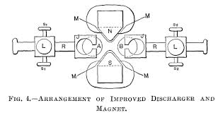
EXPERIMENTS WITH ALTERNATE CURRENTS OF HIGH POTENTIAL AND HIGH FREQUENCY
One of the changes is that the adjustable knobs A and B of the discharger are held in jaws of brass, J J, by spring pressure, this allowing of turning them successively into different positions, and so doing away with the tedious process of frequent polishing up

Slide 6
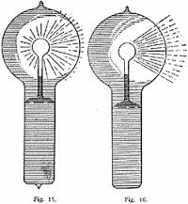
EXPERIMENTS WITH ALTERNATE CURRENTS OF HIGH POTENTIAL AND HIGH FREQUENCY
Warming the bulb or increasing the potential hastens the transit.
When the brush assumes the form indicated in Fig. 16, it may be brought to a state of extreme sensitiveness to electrostatic and magnetic influence

Slide 7
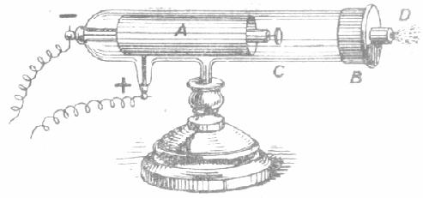
Lenard Rays
Rays emanating from the outer surface of a plate composed ofany material permeable by cathode rays, as aluminium, which forms aportion of a wall of a vacuum tube, or which is mounted within the tube andexposed to radiation from the cathode. Lenard rays are similar in all their known properties to cathode rays. So called from the German physicist Philipp Lenard (b. 1862), who first described them.

Slide 8
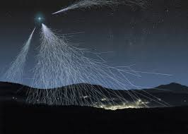
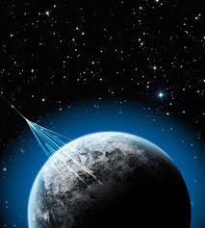
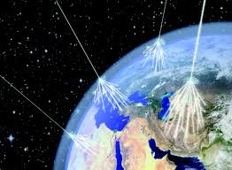
What are Cosmic Rays ?
Cosmic rays are immensely high-energy radiation, mainly originating outside the Solar System.

Slide 9
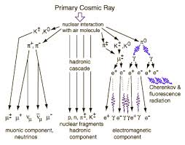
Primary and Secondary Cosmic Rays
Primary cosmic rays primarily originate from outside the Solar System and sometimes even the Milky Way.
Secondary cosmic rays enter the Earth's atmosphere they collide with molecules, mainly oxygen and nitrogen.

Slide 10
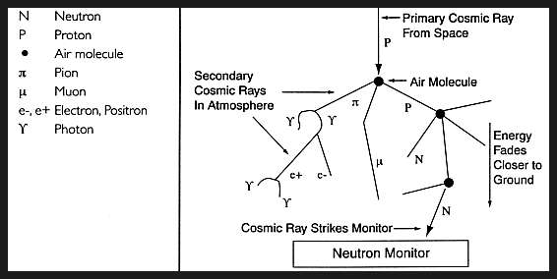
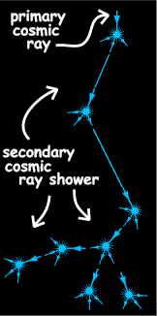
Primary and Secondary Cosmic Rays
The difference between primary and secondary cosmic rays is essentially one of convenient classification rather than of fundamental type: primary cosmic rays are those which are created by external sources like our own Sun, while secondary cosmic rays are those which are created when primary cosmic rays interact with matter in the interstellar medium, resulting in the emission of new rays.

