Slide 1
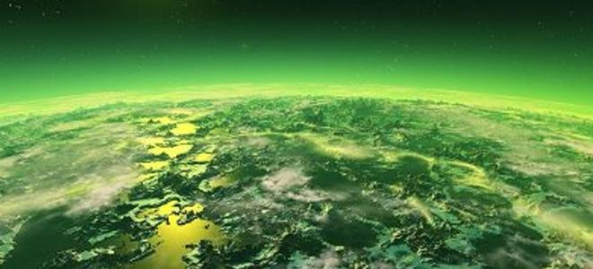
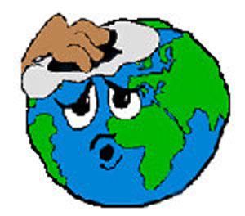
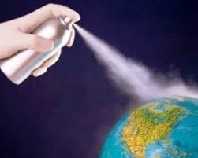
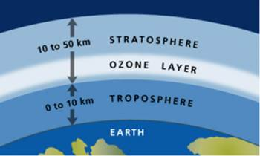
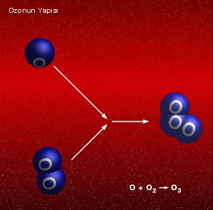
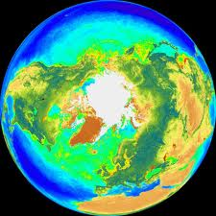
OZONE LAYER

Slide 2
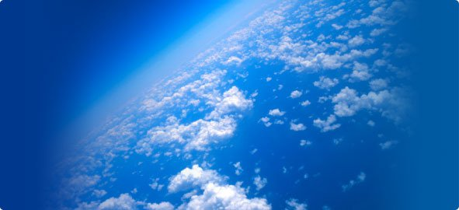
PRESENTATION CONTENT
1. What is the ozone layer?
2. Ozone (O3) gas is?
3. Ozone layer formation process
4. What is the function of the ozone layer?
5. What is the ozone hole?
6. Ozone Layer Depleting Chemicals
7. What are the consequences of the thinning of the ozone layer?
8. Distribution of ozone layer around the Earth

Slide 3
1. What is the ozone layer?
Ozone (O3) consisting of three oxygen atoms gazdır.ozo transparent layer, consisting of ozone in the atmosphere above the level of the ground surface, in other words it is a sheet with 10-50 km altitude. The main role of this layer, ultraviolet (UV) rays of the sun called us is to protect.Ozon layer against harmful UV rays reaching the earth to protect against the harmful rays that acts as a filter.

Slide 4
2. Ozone (O3) gas is?
Ozone consists of three oxygen atoms with the molecules of toxic, colorless gas and is located in the upper layers of the atmosphere ... the sky's blue color is due to appear in this gas. A navy blue color that turns into liquid form ozone, ultraviolet radiation from the sun against the world remains. However, this gas is very dangerous to live at the same time. When exposed to the eyes, nose and throat irritate the respiratory system destroys. Very few people are aware of how deadly ozone. One gram of the two ozone get one percent can be lethal. Hair spray, put a box of pure ozone Given that, the box is claimed to be fully killed 14,000 people.

Slide 5
3. Ozone layer formation process
Before the emergence of life , carbon dioxide, nitrogen and other heavy gases, the Earth's mantle and crust layer was compelled by the media . These gases earth's gravitational force retained by , and eventually, an atmosphere in geldi.yerçeki LAN, methane (CH4 ), carbon dioxide (CO2 ) , ammonia (NH3) , hydrogen (H2 ), nitrogen ( N2) and water vapor ( H2O ) that to accumulate in the atmosphere has caused . Over time, the world , the water vapor condenses into a liquid cooled enough to allow to come . This situation has brought with it rain and strong hurricanes . Continuous rain has led to the formation of the sea . Severe hurricanes affect the earth's surface was formed during electricity .
Meanwhile, because there was no oxygen in the atmosphere freely combine with hydrogen, oxygen, water , also combine with other elements in the earth crust, iron oxides, silicates, carbon dioxide and carbon monoxide posed. Oxygen , for a period of about 2 billion annually all over or otherwise attached to other elements was found.

Slide 6
The first living creatures , there is no free oxygen in the atmosphere for oxygen -breathing creatures that were anaerobic . ( Live the emergence If you would like more information about " how life began on Earth ?" You can browse to the answer . ) Anaerobic respiration occurs in the later evolution of photosynthesis , ie, capable of photosynthesis appeared live . These creatures using the glucose and oxygen to produce water and carbon dioxide began . So called free oxygen atmosphere stratosphere began to accumulate in layers . Ultraviolet rays, these layers oxygen molecules ( O2 ) by multiplying these molecules into two oxygen atoms ( O + O ) cleavage caused. These oxygen atoms combine with oxygen molecules formed ozone . ( O + O2 > O3). Ozone layer was thus formed . In addition, this reaction occurs in the same way nowadays . Since there is enough oxygen on ozone layer has a thickness limited. The ultraviolet rays can not reach to the lower layers .

Slide 7
4. What is the function of the ozone layer?
Ozone concentration in the air at one of olangaz dünyaiç although presence is crucial. Because of stratospheric ozontabaka from space as a shield to many harmful ışınlarakarş görmektedir.ozo a wavelength of less than 2400 angstroms, and the radiation rays react with the bottom layer to prevent passage. Wave boyu2800 smaller than angstrom damage of ultraviolet rays on living organisms are known to make. The ozone layer in the stratosphere and 2400 Angstroms rays by absorbing smaller from space, a large portion of organisms harmful rays of the proof of our world. Of the ozone layer, the world has an impact on the overall climate. Reduce the temperature to absorb ultraviolet rays and helps to regulate the heat balance.

Slide 8
5. What is the ozone hole?
The ozone hole is not really a hole. Is a thinning in the ozone layer. This means that the ozone layer is getting thinner. The reason we are the chemicals emitted into the air. These chemicals are used in our everyday lives and can damage the ozone layer.
6. Ozone Layer Depleting Chemicals
1 - chlorofluorocarbons (CFCs), in general air conditioning systems, refrigerators production of foam (e.g., deposits) used.
2 - halons, used in fire extinguishers.
3 - Methyl bromide, used as pesticides in agriculture.

Slide 9
7. What are the consequences of the thinning of the ozone layer?
Ozone hole main result of the earth more UV rays (especially very dangerous UV is to reach. UV rays from sunburn, skin cancer can cause, damage the eyes (cataracts), and in people weakened immune system can cause. Known as the immune system against diseases that allows us to It is a system. this system is weakened when to fight disease our ability will be weakened. UV rays not only affects our health but not on the environment also has negative effect. agricultural production can reduce the marine food chain, disrupting the fish population is affected.

Slide 10
8. Distribution of ozone layer around the Earth
The ozone layer is not distributed evenly around the world. The amount of ozone in the Earth's surface anywhere on its natural with the exact latitude, and from day to day varies with the seasons.
In general, under normal circumstances, the thickest ozone layer over the poles and the equator is the finest around. Solar radiation is much more straightforward and it is much more severe depending on the equatorial stratospheric ozone is produced in high quantities. In contrast, stratospheric winds and pressures of different stratospheric ozone from the equator to the poles to move toward the cause.

Slide 11
Seasonal changes in ozone , air masses is believed to be associated with large-scale movements . Very down latitudes ( near the equator ) from the stratosphere to the upper atmosphere slowly yükselic believed in the existence of a general air flow . This air mass in the Arctic region during the winter months traposfer returned. Stroke of the air at high latitudes in winter , too cold during this season 15-40 km high, not too heavy and dense and therefore is based on the fact .
Daily changes on a specific region , is closely related to weather conditions in the upper atmosphere . Pressure on the earth's surface and by daily temperature changes are close correlation between the height of the stratosphere . Consequently the amount of ozone on a particular region varies with changes in these factors . Of anticyclones (high pressure areas ) ozone reduced in thickness below normal , whereas in depression , and especially to the west of the center of low pressure is above normal .

