Slide 1
1st Article:
RISKS IN COMPUTER AND TELECOMMUNICATION SYSTEMS

Slide 2
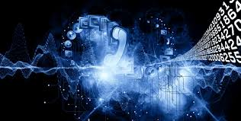
TELECOMMUNICATION - TELECOMMUNICATION NETWORKS
Telecommunication is communication at a distance by technological means, particularly through electrical signals or electromagnetic waves.
A telecommunications network is a collection of terminal nodes, links and any intermediate nodes which are connected so as to enable telecommunication between the terminals.

Slide 3
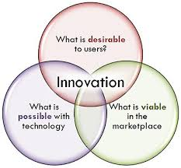
TECHNOLOGICAL INNOVATION
Innovation
Noun
The act of introducing something new
Ex.; Technological innovation has driven changes in the underlying economics of the industry.

Slide 4
INTEGRATION
Noun
mixing things or people together that were formerly separated.
Ex.; There has been an enormous amount of academic and policy work on the integration of minority cultural communities into mainstream’ society in the last decade.
AUTOMATED OPERATIONS
Tools and techniques that help you improve your installation's productivity. As your system grows more complex and your message traffic increases, automating certain tasks can increase efficiency of your system.

Slide 5
RELIABILITY
noun
The degree to which a person, measure, or object is dependable. For example, vehicles manufactured by certain companies are considered to have above-average reliability.
CONTINUITY
noun
It refers to something occurring in an uninterrupted state, or on a steady and ongoing basis.

Slide 6

EDP-ELECTRONIC DATA PROCESSING
It can refer to the use of automated methods to process commercial data.
Typically, this uses relatively simple, repetitive activities to process large volumes of similar information.
For example:
Booking and ticketing transactions
to an airline's reservation
System AND
billing for utility services.

Slide 7
DATA (Noun)
Facts or figures, or information that's stored in or used by a computer.
ERROR (Noun)
It refers to a mistake or the state of being wrong.
FRAUD (Noun)
Something said or done in a dishonest way to trick people.

Slide 8
DEFAULT
Noun
failure to do something.
Ex.; Once a bank becomes unable to pay because of system problems, default, or any other reason, the banks that have loans outstanding to that bank also incur bad debts.
DEPT
Noun
Debt is defined as owing money
An example of debt is what you owe on your mortgage and car loan.

Slide 9
TO EXPOSE
Verb
to make something visible or make something known.
Ex,; Banks have always been exposed to risks such as error and fraud.
TO DEMONSTRATE
Verb
to show by reasoning; prove
to explain or make clear by using examples, experiments, etc.
to show the operation or working of; specif., to show (a product) in use in an effort to sell it.

Slide 10


A CHAIN REACTION
Noun
1. A chemical reaction or other process in which the products themselves promote or spread the reaction.
2. The self-sustaining fission reaction spread by neutrons that occurs in nuclear reactors and bombs.

Slide 11
TO PASS ALONG
Verb
To transmit information, to communicate, to pass on, to pass, to put across
TO THREATEN
Verb
To pose a danger to someone or something, or to make someone believe you pose a danger by making statements indicating an intent to harm them
Ex.; When you tell someone you are going to kill him, this is an example of a time when you threaten him.

Slide 12
IMPROPER DISCLOSURE OF INFORMATION
Disclosure (noun); the act of revealing or something that is revealed.
Improper Disclosure of Information; act of revealing information in an inappropriate (Improper) way (or illegal way)
Ex.; Improper Disclosure of Information is one type of risk in EDP environment and so the security and control procedures deserve the full attention of supervisors.

Slide 13
INTERRUPTION
Noun
Something that causes a stop in action.
An example of an interruption is a person bothering someone who is working hard.
Ex.; The interruption of mining has pushed up the prices of gold and platinum.
FAILURE
Noun
Act of falling short (failing) of the goal or a person who hasn't achieved what they set out to.
Ex.; Don't let a computer failure destroy your precious memories.

Slide 14
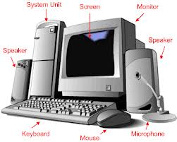
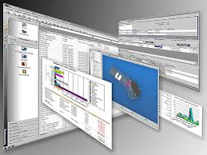
HARDWARE
noun
is the physical components of a computer such as the machine and wiring, or tools and machinery, or heavy military equipment.
SOFTWARE
noun
Software is the programs and routines for a computer or the program material for an electronic device which make it run.

Slide 15

CLIENT
Noun
A company or a person who uses services.
It could be a lawyer, accountant, advertising agency, etc. is acting a customer
Ex.; Bank managers look for employees with the experience of working for a multicultural client population.

Slide 16
EMPLOYER
Noun
A person or a business that gives a paying job to one or more people. The company you work for is an example of your employer.
EMPLOYEE
Noun
A person who works for someone else or a company in exchange for wages or some other agree-to compensation.
An example of employee is an individual who is employed by McDonald's and is paid a certain amount of money for each hour worked.

Slide 17
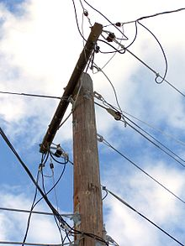
TELEPHONE LINE
Noun
telephone wire, the wire that carries telephone signals.
Ex.; A telephone line or telephone circuit is a single-user circuit on a telephone communication system.

Slide 18
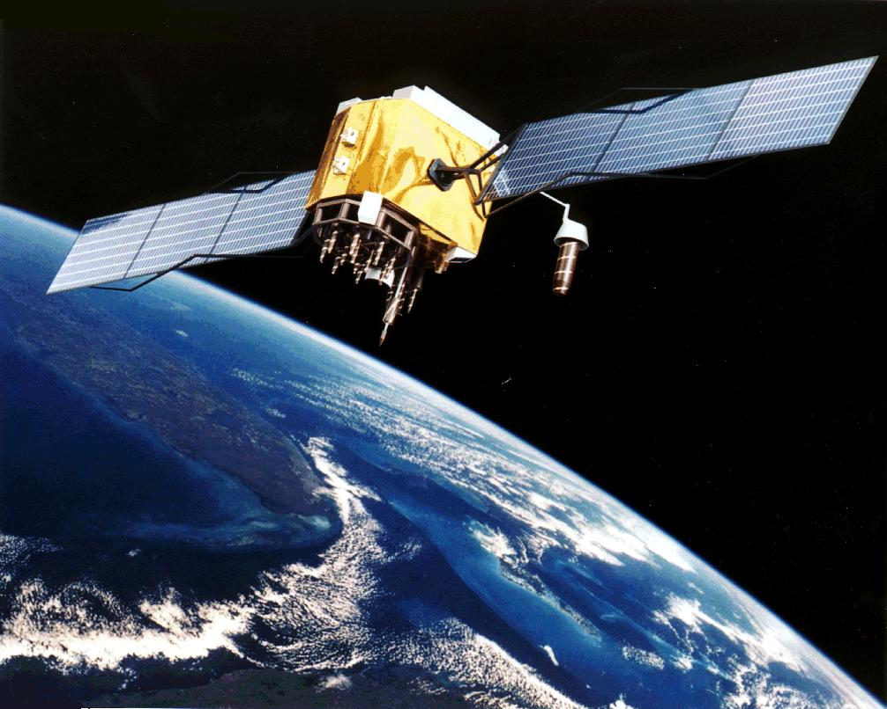
SATELLITES
(General) a planet orbits a sun and a moon orbits a planet.
A manmade object that orbits the Earth (Article)
Ex.; Thousands of satellites fly overhead every day, helping us with things like weather forecasts, scientific research, communications, and TV broadcasts.

Slide 19
TO TRANSMIT
Verb
to transfer, or cause something to be transferred from one person to another or one place to another.
(1) When you give someone a cold you have, this is an example of a situation where you transmit the cold virus.
(2) When you cause information to be shared with a new person, this is an example of a situation where you transmit information.
(3) When you broadcast a TV show, this is an example of a situation where you transmit the TV show.

Slide 20
ACCESS
Noun
The definition of access is the right to use, communicate, or approach something or someone.
- An example of access is permission to enter a secure area.
Access is defined as the way to enter or exit a place.
- An example of access is a road that connects a house to a highway.
Verb
Access means to approach, use, or enter something.
- An example of access would be viewing your bank account from your computer.

Slide 21
TO IMPROVE
Verb
The definition of improve is to make something or someone better, or to become better.
An example of improve is when you make a new product that is better than the old one.
An example of improve is when you practice piano until you learn to play better.
Ex.; Automated operations are tools and techniques that help you improve your installation's productivity.

Slide 22
TO ABUSE
The definition of abuse is the use of something for the wrong purpose. (IN ARTICLE)
An example of abuse is when a politician takes public finds for personal gain.
Abuse means to hurt or injure something or someone by acting badly or neglectfully.
Abuse is defined as injury or insult.
An example of abuse is not providing for the physical needs of a child.

Slide 23
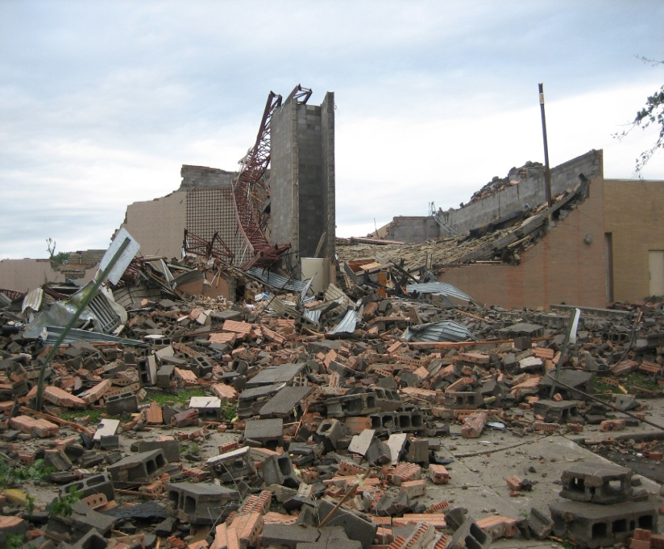
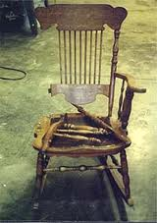
DAMAGE
(verb, noun)
injury or harm to a person or thing that reduces health, value or usefulness.
An example of damage is a chair (sth) that's been broken
An example of damage is the devastation after a tornado

Slide 24
TO PROTECT
Verb
Protect is defined as to defend or guard from danger or loss.
An example of to protect is installing an alarm system in your home.
TO RESTRICT
Verb
Restrict is defined as to keep someone or something within certain limits.
Ex.; Your website access has been restricted for downloading pirated software.

Slide 25
TO TRANSFER (noun or verb)
To move, carry or transport from one person or place to another.
An example of to transfer is the owner of a car signing the title over to a new owner.
An example of to transfer is picking up a package from one location and bringing it to another.
MAINTENANCE (verb and noun)
Providing support or upkeep to something.
Ex.; The roads which are affected by the major construction and maintenance projects are listed here.

Slide 26


AUDIT (verb&noun)
The process of evaluation or analysis of something to determine its accuracy or safety, or is the document that declares the result of such an analysis or evaluation.
AUDITOR (Noun)
a person authorised to audit accounts
a public official who audits government accounts, distributes revenues, assesses real-estate, inspects scales, etc.
Audit stamp

Slide 27
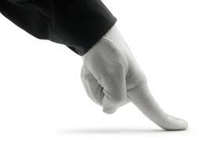
TO INSPECT (verb)
To carefully look over someone or something, especially to determine if minimum criteria or standards are met.
INSPECTOR (noun)
a person who is entrusted with the authority
to check something to determine quality.

Slide 28
PROCESS (verb&noun)
The definition of a process is the actions happening while something is happening or being done.
An example of process is the steps taken by someone to clean a kitchen.
An example of process is a collection of action items to be decided on by government committees.
TO BACKUP (verb)
To duplicate a copy of data or of the entire hard drive
Ex.; You should always backup your critical data files for the prevention of losing them in any failure of your computer system.

Slide 29
CONFIDENTIAL (adj)
secret, private, or shown in trust.
An example of confidential is a diary.
An example of confidential is a government document.
Ex.; The company had promised buyers that any information acquired would remain confidential.
REPUTATION (noun)
It is the way you are viewed by people and by your community and the way these people think of you.
An example of reputation is the general belief that someone is a nice, honest and hard working person.

Slide 30
LOSS (Noun)
having something or someone leave or be taken away
An example of loss is when your company is not profitable and spends more than what is made.
TRANSACTION (Noun)
An exchange, or an instance where business is done or something is bought or sold.
When you go to the store and buy something, this is an example of a transaction.

Slide 31
PROCEDURE (noun)
1- A set of steps for doing something.
2- The established way of carrying on the business of a legislature, law court, etc.
An example of a procedure is cracking eggs into a bowl and beating them before scrambling them in a pan.

Slide 32
COMMAND (noun)
The order(s) to exercise authority or power over something.
An example of command is a dog owner telling their dog to sit.
VIOLATION (noun)
breaking a rule or law or of a code of behaviour.
(1)When you drive your car faster than the speed limit, this is an example of a violation of the law.
(2) When you read someone's diary this is an example of a violation of privacy.

Slide 33
AMENDMENT (noun)
Is a change, addition, or rephrasing of something, most often with the intention of improvement.
BACKLOG (noun)
The work that has yet to be completed.
Any jobs that are not finished by the end of the day is an example of a backlog.
verb
To hold on to any delivery orders that do not need to be made until the following week is an example of backlog.

Slide 34
TO ABANDON (verb)
To leave something behind.
An example of abandon is leaving a baby on a stranger’s doorstep.
TO REMOVE (verb)
To take something away or eliminate something.
When you clean your oven, this is an example of a situation where you remove dirt.

Slide 35
SOUND (adj)
something that is in good condition.
An example of sound is a well made chair.
CRUCIAL (adj)
Something that is essential or vitally important.
An example of crucial is information that a bomb is about to go off.

Slide 36

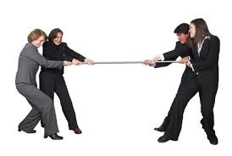
COMPETITOR (Noun)
One that competes with another, as in sports or business; a rival.
Ex.; Check out the direct competitors of the bank and compare the performance and key statistics.

Slide 37
CORRUPTION (noun)
Bribery or similar dishonest dealings
An example of corruption is a government that pretends to be for the protection of people, but is selecting vendors based on how their contracts will benefit them personally.
BREAKDOWN (noun)
A mechanical failure or a collapse of a system of authority.
When your car stops working and will no longer start, this is an example of a breakdown.

Slide 38
VULNERABLE (adj)
Easily hurt
An example of vulnerable is an animal with no protection
An example of vulnerable is a person who is easily hurt by criticism at work.
An example of vulnerable is a military base with limited defences.
VULNERABILITY (noun)
A weakness or some area where you are exposed or at risk.

